Slide 1


Hack Manchester
Co-op Challenge
October 2022

Slide 2
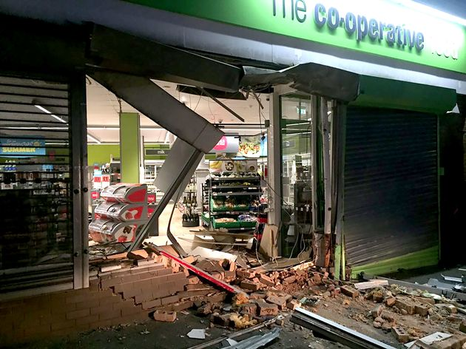
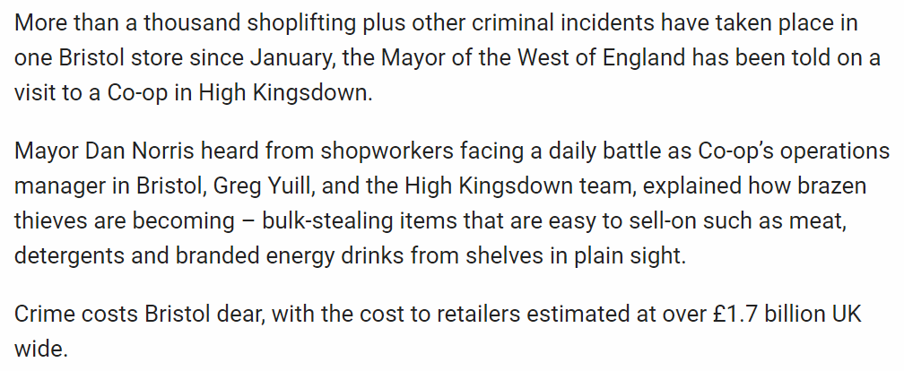

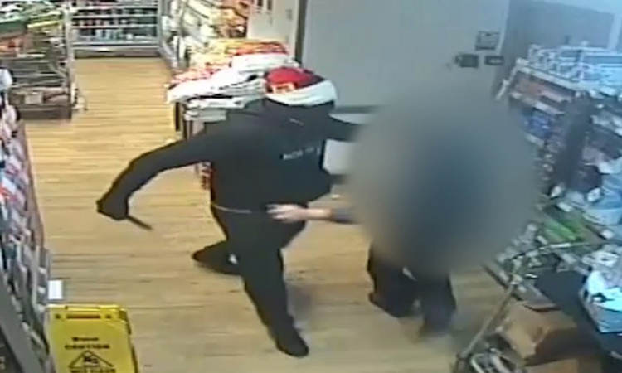

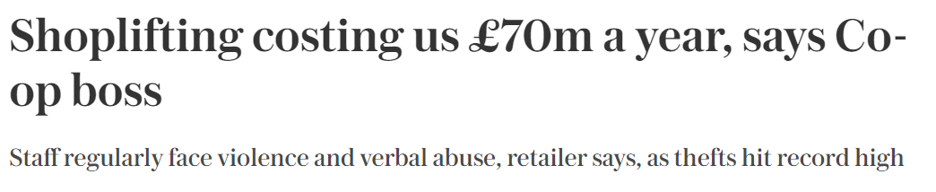
What’s in the press

Slide 3
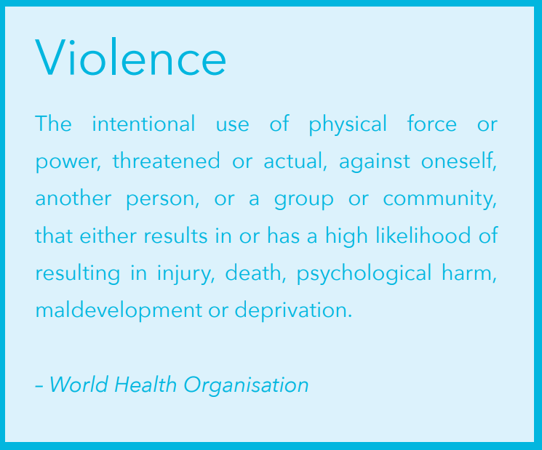

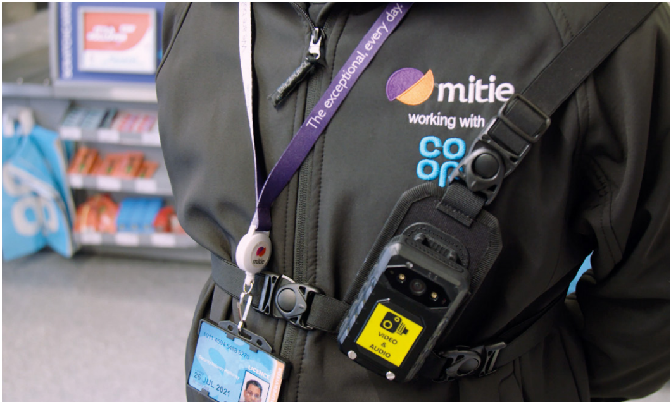

In terms of policing, eight successive years of budget cuts to Britain’s police forces stretched resources to breaking point. Central government funding for policing was reduced by 22% in real terms between 2010 and 2019, resulting in 21,000 fewer police officers in addition to 18,000 fewer police staff and 6,800 fewer police community support officers
The prison ‘system’ is also suffering. Having undergone a sharp increase in the prison population – it doubled between 1993 and 2012 (from around 44,000 to 86,000)

Slide 4
The Challenge
Create something to:
Help our colleagues in store to prevent crime;
Keep them safe during a crime;
Help them in the aftermath of a crime.

